Slide 1

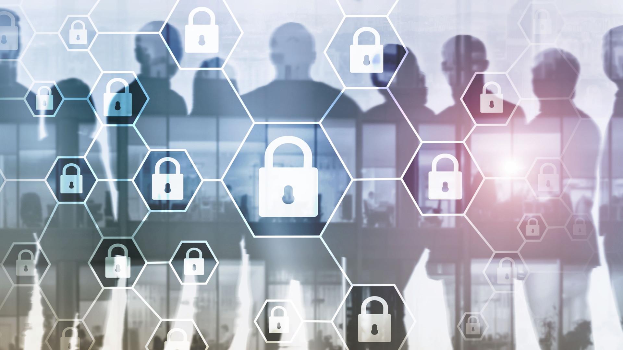
Company Name and Logo
Your Company
Cybersecurity Training
Protect yourselves online by mastering cybersecurity
best practices
Week 2
www.YourCompany.com
Notes:
This will be the second session of the training session.
Show this training slide before training begins.

Slide 2


Let us review
Basic Concepts
Notes:
Ask the staff: "Let's see what you have remembered from last week... who can tell me something about... "
Depending on how much you have, you will ask them about the concepts below. If a concept needs to be clarified, refresh their memory before moving on.
A - Basic Concepts
1. Common Misconceptions.
2. Security Awareness and common threats.

Slide 3

What we will cover
Device Protection
Notes:
Summarize the topics which will be covered in this session.
- Device Protection
Let your staff know that protecting their devices will help them not only with their company-issued devices but with their personal devices as well.

Slide 4

Device Protection
Notes:
This is an introductory slide for the next session.
Conduct a discussion in which you can ask the following questions -
- Why do we need to protect our digital devices?
- Why is it essential to protect our devices, whether company property or personal?
- What do you think the consequences are for not protecting our devices?
*Make this a discussion so they pay attention on the topic and not just the presentation*

Slide 5

Passwords and best practices
Notes:
Let your participants know that this section will cover how to manage passwords properly.
Continue to let them know that there are going to be tips and tools to help them manage passwords and understand how to create an effective password.

Slide 6
Passwords and best practices
Personal Information
Easy to Guess
Can be obtained publicly
Birthdays, names and Pets names.
Symbols
Notes:
Let them know not to use discernible and personal information in their passwords.
Discuss the following as information which should be avoided when creating passwords:
I. Easy to guess - Personal and known information makes it easier for others to guess the passwords
II. Can be obtained publicly - Personal information can be gathered publicly through various outlets such as social media. Be careful what kind of information you post.
III. Birthdays, names, and even pet names should not be used.
- Using symbols will not help if the password is distinguishable and comes close to a relevant word.

Slide 7
Passwords and best practices
Password Strenght Tool
https://lastpass.com/howsecure.php
https://bitwarden.com/password-strength/
Notes:
In this slide, let them know that you will provide online tools to help them generate strong passwords.
Provide them with these links, which are free and capable of testing their password's strength and generating a strong password.

Slide 8
Passwords and best practices
Repeated Passwords / Frequent Change
Affect other accounts
Increase risk of credential attacks
Difficult to remember passwords
Notes:
Discuss and Explain the need to not use the same password across multiple devices or services.
The following is essential information on why we should not be repeating passwords.
I. Affects other accounts - If an attacker gains access to one of your accounts, they may also be able to use the same password to access other accounts.
II. Increases the risk of credential attacks - This is where an attacker uses a list of stolen usernames and passwords to gain access to accounts on other websites
III. Difficult to remember - If you use the same password across multiple accounts, you may be tempted to use weak passwords. This leaves all of your accounts vulnerable to attacks, as weak passwords are easier to crack by attackers.

Slide 9
Passwords and best practices
Two Factor Authentication (2FA_ or Multiple Factor Authentication (MFA)
Notes:
First, explain what two-factor authentication or multi-factor authentication is.
Explain the following:
I. This authentication method wherein in addition to your username and password, an additional series of codes are sent to your phone via SMS or email to verify your identity.
II. Two-factor Authentication sends you two methods.
The first method of authentication in this step involved entering a password. The second method (two-factor) is a code sent to your phone or email which you have to enter to verify your identity.
III. Multi-Factor Authentication sends you several methods before granting access.
After sending you an email, you may have to click the link and answer an additional question. These are more common in financial institutions.

Slide 10
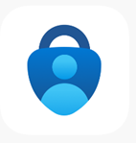
Passwords and best practices
Other methods of 2FA and MFA
Microsoft Authenticator App
Notes:
Introduce them to another form of authentication, such as the Microsoft Authenticator App.
Explain to them that instead of receiving an email or SMS, this app generates a secure code for you to enter in addition to your password.
Explain that this app gives you a code that changes every 30 seconds. It serves as a replacement for receiving codes via phone or email.

Slide 11
Passwords and best practices
Password Managers
Generates complex passwords
Stores passwords securely
Saves time
Notes:
In this section, we will Introduce password managers to your staff.
I. First, Explain what password managers are.
A. Password managers are software applications that help users generate, store, and manage complex and unique passwords for their online accounts.
II. Explain the benefits of password managers.
A. Generates complex passwords - Password managers generate complex and unique passwords for each account, making it more difficult for hackers to guess or crack passwords
B. Stores passwords securely - Stores all your passwords in one secure location.
C. Saves time - by automatically filling in login credentials for websites and apps. This eliminates the need to remember and enter passwords manually

Slide 12
Passwords and best practices
Password Managers
Complex Passwords or Password Generators
Difficult to guess
Unrecognizable
Not personally relatable
Notes:
Explain that Password managers can generate complex passwords, then explain the importance of complex passwords
I. More difficult for hackers or others to guess your password.
II. It uses passwords you may otherwise not think of
III. No personal information is related to complex passwords

Slide 13


Passwords and best practices
Complex Passwords or Password Generators
LastPass
1Password
Notes:
Provide some tools of password managers that manage passwords and links that can help generate a secure password.
I. LastPass (www.lastpass.com)
II. 1Password
(www.1Password.com)

Slide 14
Avoiding Risky Downloads and Attachments
Notes:
The following slide will be the beginning of the next section.
Let them know that next, we will discuss the need on how to "avoid risky downloads and attachments."

Slide 15
Avoiding Risky Downloads and Attachments
USB and other External Drives
Entry point for infected files
Curiosity
Notes:
Explain the following on why unknown USB drives can be a danger.
I. Entry point for infected files - USB Drives and other storage devices plugged into your PC can be an entry point to being infected
II. Curiosity - Unknown USB devices and curiosity. Out of curiosity, we tend to look at files we do not know. From unknown sources, these files can often be infected, affecting our systems.

Slide 16



Avoiding Risky Downloads and Attachments
Alternative Solution
Dropbox OneDrive GoogleDrive
Notes:
Present an alternative resource for storing data, Cloud Storages.
I. If your company uses any of these or a different company, encourage your employees to use this provided resource.
II. additionally, it backups up your data in the cloud, which can be recoverable when something happens to the device.
III. It is also something convenient and can be used for other personal projects they are working on.
*Let your staff know that these practices would not only help them interact with company assets, but it is also valuable for their interaction with digital assets.*

Slide 17
Avoiding Risky Downloads and Attachments
Via email
Name matches
Never verify information
Too good to be true?
Your real name
Notes:
Let the attendees know that email is one of the most common entry points. Be aware of your emails.
The simplest way to is to be aware. Here are some tips:
I. Make sure the email sender's email and name match.
II. Legitimate emails should never ask you to verify your information.
III. If it seems too good to be true, chances are it is.
IV. Suspicious emails will not address you by your name because they don't know your name. They discussed just you by email; they have gotten a hold-off.
Let them know that the following pages will give them an example.

Slide 18
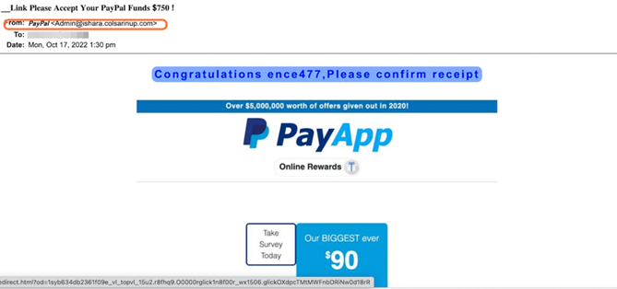
Avoiding Risky Downloads and Attachments
Malicious e-mail and spam Figure 1
Notes:
This slide will show them an example.
Explain why this is a dangerous email after showing them the following example figure.
The following are the reasons that make it a dangerous email.
I. The sender's name is labeled PayPal, but the email is unrecognizable. (Point to the sender)
II. They address you by email instead of your name. These institutions should have your name on the file. (Point to the email body next to Congratulations...)

Slide 19
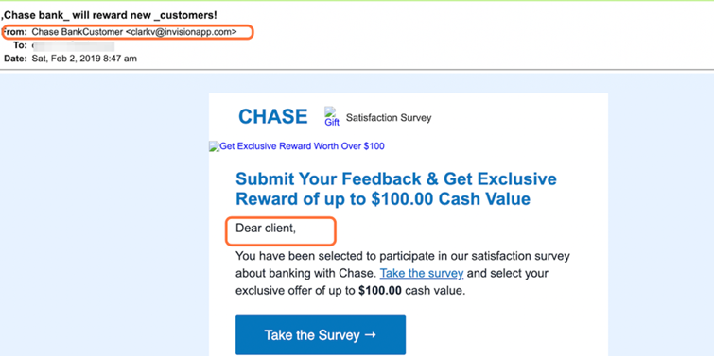
Avoiding Risky Downloads and Attachments
Malicious e-mail and spam Figure 2
Notes:
In this slide, we will use another example your employees are more likely to encounter.
Show them a sample of a second email sample.
Explain the following reasons that make this a dangerous email.
I. The sender's name is labeled Chase, but the email is unrecognizable.
II. They address you by "Dear client" instead of your name

Slide 20
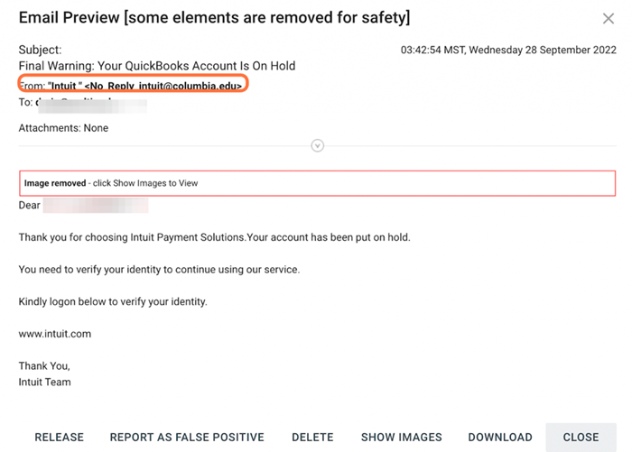
Avoiding Risky Downloads and Attachments
Malicious e-mail and spam Figure 3
Notes:
Show this slide with a third example.
In this third example, explain why this is a suspicious email.
I. The image shown is the most suspicious of all examples.
II. The sender's name is Intuit, but the email differs.
III. They address you by email instead of your name. These institutions should have your name on the file.

Slide 21
Screen Lock
Notes:
The following section will discuss how to secure yourself from locking your screen.
Let them know this section will discuss the importance of securing your screen.

Slide 22
Screen Lock
Prevent unauthorized access
Protect sensitive information
Maintain privacy
Notes:
Explain the following essentials on why locking your screen is good practice
I. It prevents anyone from accessing your computer or data without your permission.
II. If you work with sensitive information, leaving it on your screen when you step away could lead to a security breach.
III. It prevents others from seeing what you are working on or accessing your private information.

Slide 23
Oudated Software
Notes:
This next topic will discuss the dangers of outdated software and the importance of updating software for your devices.

Slide 24
Outdated Software
Security Flaws
Prime target
Improves performance
Incompatibility
Notes:
Explain to the individuals the importance of updating software.
Say the following..
"As technology evolves, so do criminals' tactics when discovering new ways to compromise data."
Discuss the following with the attendees.
I. Security Flaws 0 There may be new security flaws discovered. With new flaws and vulnerabilities, hackers may get into your system. It does not have the latest patches.
II. Prime target - Outdated software is also an easier target for bad actors to get into since it is easier to access and manipulate.
III. Improves performance - In addition to protecting yourself, having updated software also improves the performance of your system and will include updated features that will be more convenient.
IV. Incompatibility - Additionally, old software may not be compatible with newer ones. By updating software regularly, not only do you ensure that you have the latest, but it also provides you with compatibility.

Slide 25
Outdated Software
Reach out to update
Latest Version
Notes:
Let them know to reach out if they have issues updating their software,
They can also just reach out if they want to have an updated version.

Slide 26
Questions
Notes:
Ask the training attendees if they have any questions that need to be addressed.
Open this section for interactive discussions.

Slide 27
Recap and Takeaways
Notes:
Review what the attendees have understood and ask around what they have learned.
Ask them for a takeaway from today's session.
Asking around reinforces what they have learned and can also teach others.

Slide 28

Company Name and Logo
Thank you
for your attention
www.YourCompany.com
Notes:
Thank the attendees and congratulate them for completing this session.
Let them know to review the materials provided and that they can ask questions after this training session.
Remind them of the next session date and time.

